Slide 1

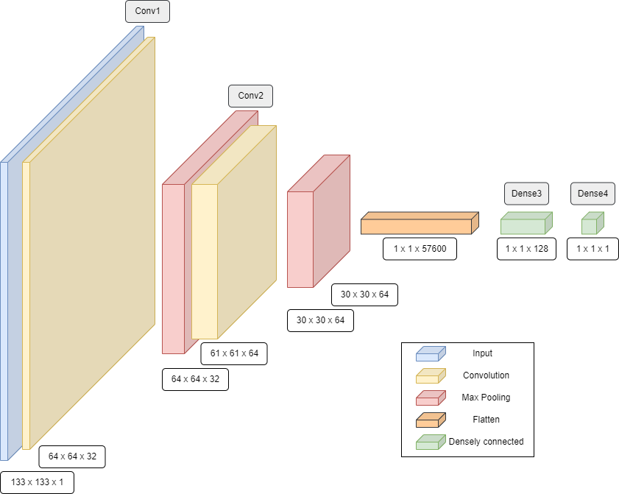
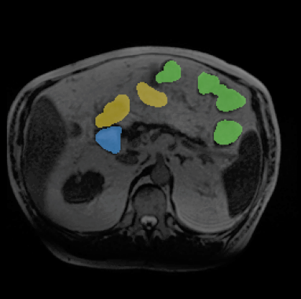
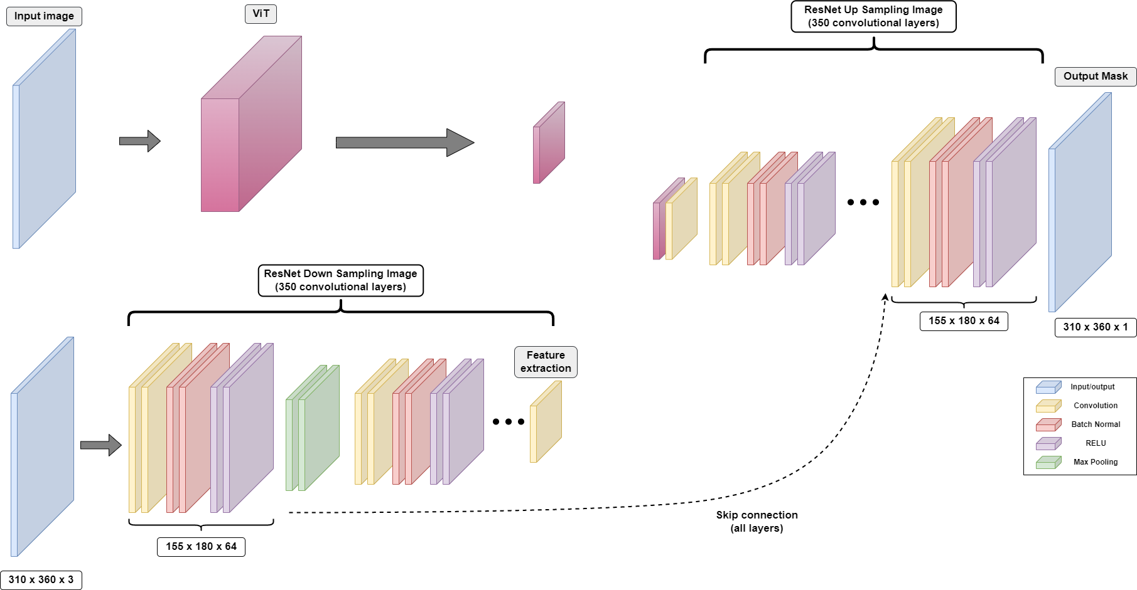
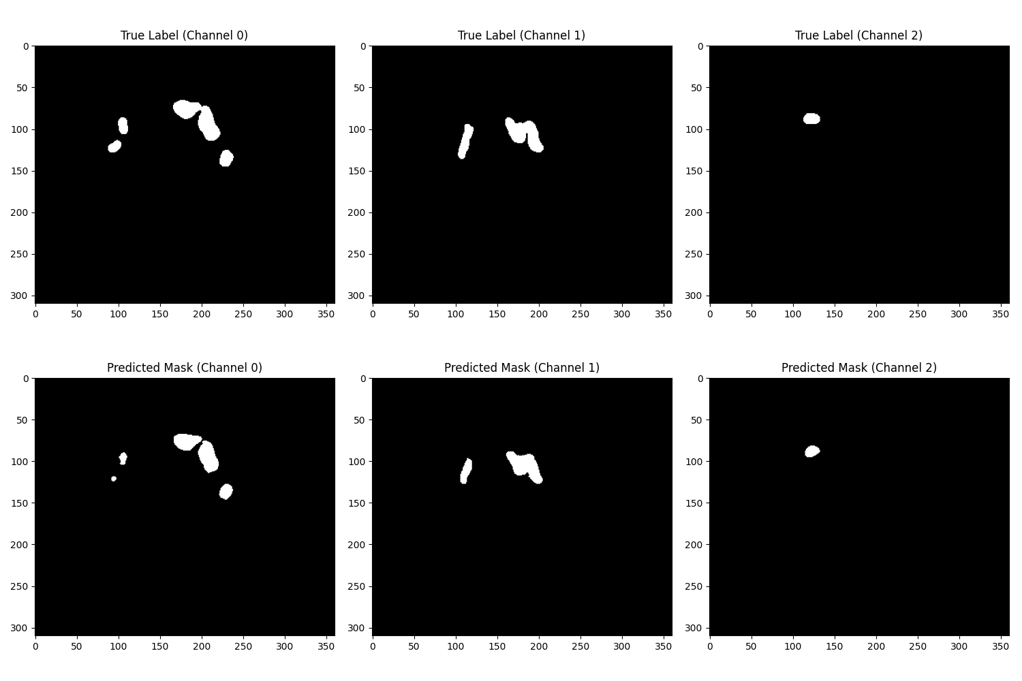
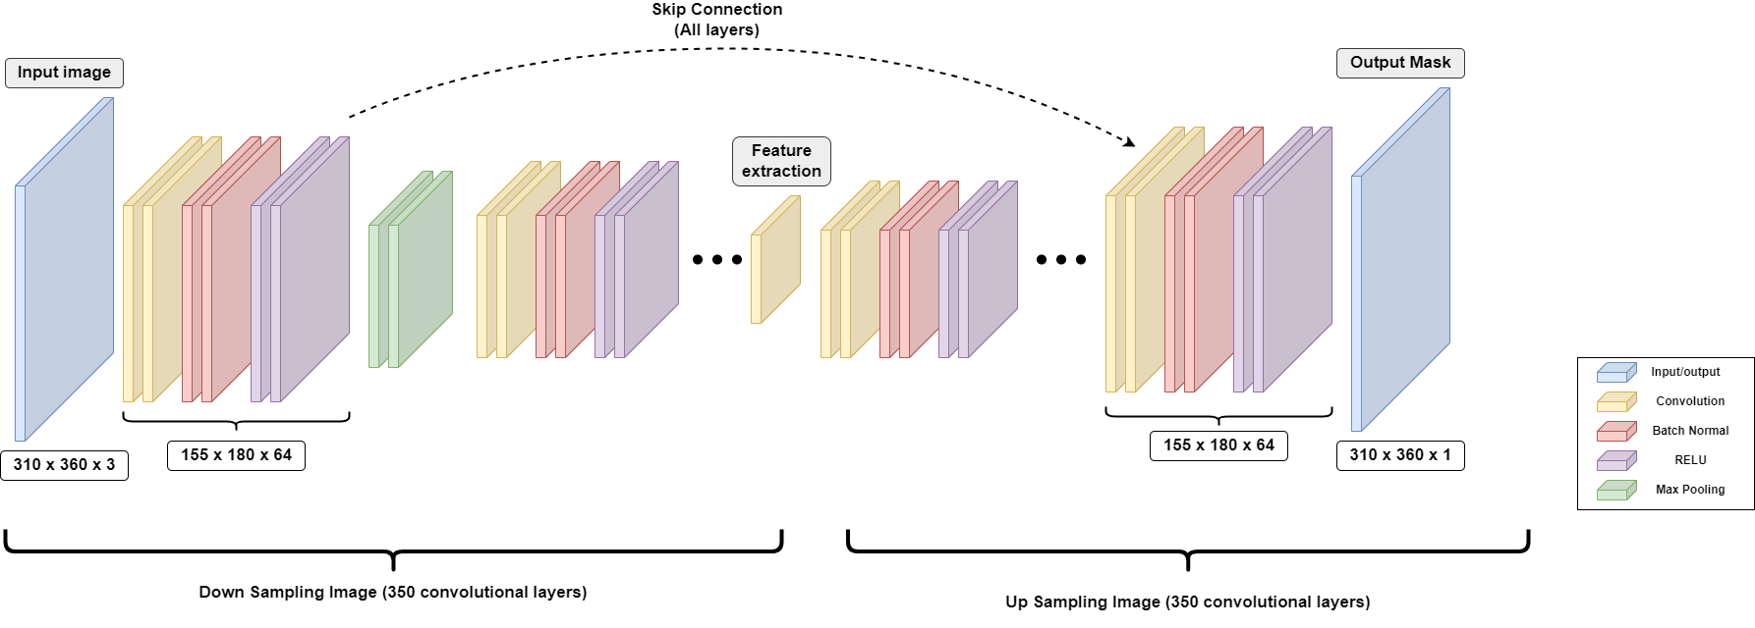
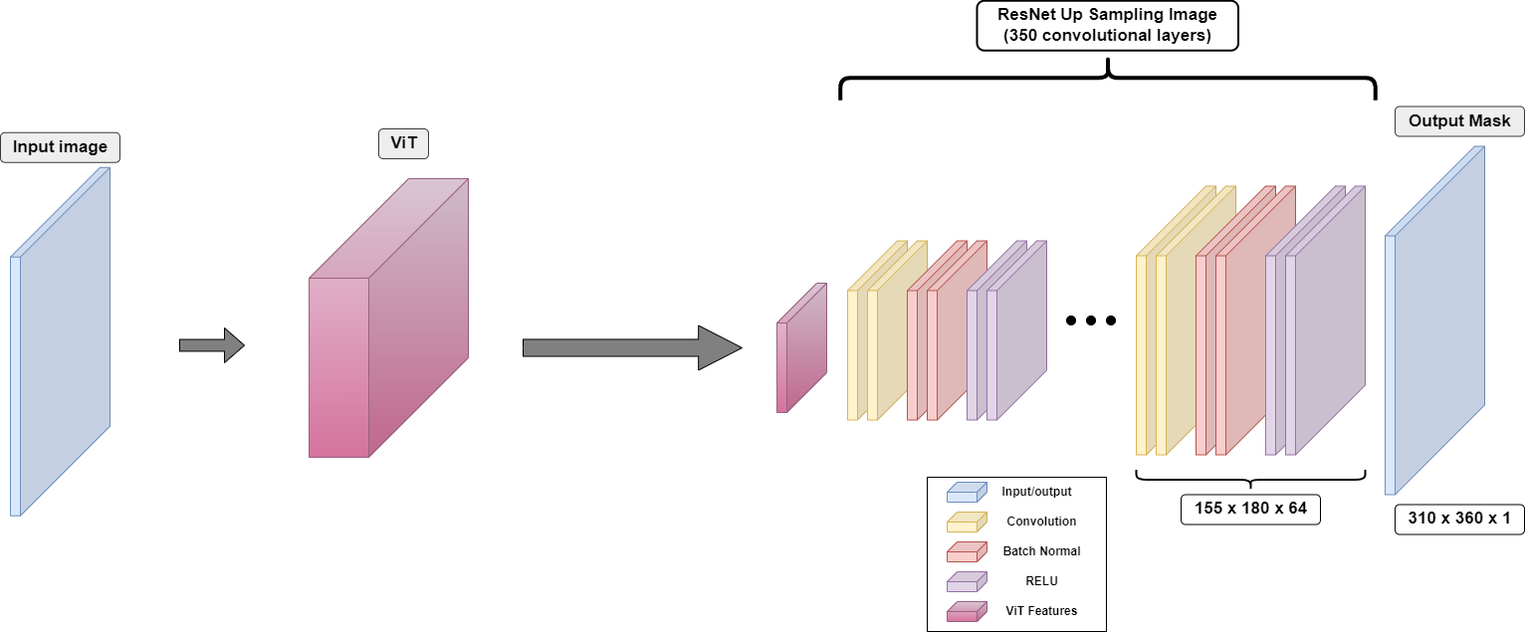
Application of Convolutional Neural Networks in Gastrointestinal MRI Image Segmentation
By: Ryan Donoghue, Gabriel Vieira, Rongzhi Zhang, Mingyu Zhong, Ruide Li
Introduction
Motivation: Cancer treatment is an exhaustive and complicated process for both patients and doctors. Many treatment times take upwards of hours to complete, with doctors having to trace MRI images by hand to plan a patient's treatment. Any reduction in these manual processes could have a profound effect on the overall care a patient receives.
Problem statement: The manual process of mapping out the ever-changing positions of tumors from MRI scans in order to administer radiation treatment is painstaking and time consuming. This is burdensome on both the patients, who face uncomfortable and inconvenient wait times in an already undesirable position, as well as the medical professionals. This process can be automated using existing machine learning techniques.
Average Test Error
Dice Loss
Focal Loss
ResNet
ResNet/ViT
Vi
Methods
Stage 1: classification (pre-processing)
Stage 2: Segmentation
Alternative Architectures:
Results
Stage 1 - Classification
Filter out the images with a threshold 0.00001 instead of usual 0.5
Effectively prevent ⅔ of the images without organs of interest continue to next step
Stage 2 - Segmentation
Loss function - 0.33 * Focal Loss + 0.67 * Tversky Loss
Customized Loss to address the class imbalance issue in the data
Focal loss - generalization of BCE loss that measures/minimizes the pixel wise difference
Tversky loss - generalization of Dice loss that measures/maximize the overlapping shape & region
Pipeline Overview
Stage 1 - classifying the given slice into 1 (organs of interest is presented) and 0 (none of the organs of interest is presented)
Maximize recall to 100% so we do not filter out any useable slices
More than 50% of the slices are the cross section of the skin which does not contain organs → filtered with a smaller classifying neural network to save resources and time
Stage 2 - Feed the went through inputs to segmentation model to yield the mask for the 3 organs of interest
U-Net architecture with Resnet-50 CNN for downsampling and upsampling
ViT paired with global feature extraction to provide additional information for upsampling
Skip connection used to provide local feature extraction to each upsampling layer
Segmentation Networks | Combined Loss | BCE Loss | Dice Loss
ResNet | 0.1258 | 0.0349 | 0.2845
ResNet/ViT | 0.1117 | 0.0366 | 0.2476
Figure1: MRI image with true mask overlayed
Justifications
2.5D Input
Our dataset would only contain ~400 fully 3D examples to train from. This is too few examples to train a 3D model.
2.5D architecture will generally train faster* than a fully 3D architecture.
Improvement over 2D approach as we are able to preserve some of the spatial relationship between slices.
ResNet Pretrained Model
ResNet was chosen at is the most advance fully convolutional Neural Network available.
The ResNet architecture trains quickly* due the the batch normalization layers.
ResNet50 was chosen as it allowed us to move to a larger or smaller architecture if we experienced any under or over fitting.
U-Net architecture
Allows skip connections
Able to provide more information to each step by include the global and local feature extraction into each layer input
*Note: Fast training time is a concern due to the timeframe in which this project needed to be completed
Training Process Overview - 2 Step Training
Step 1 - Freeze the pretrained weights and train the upsampling layer until convergence
Pretrained downsampling weights can perform feature extraction to some extent
Step 2 - Training all weights until convergence
Pretrained weights are for RGB images instead of 3 consecutive grayscale images
The alternative architectures below are the individual components of the segmentation model in Stage 2
Figure 2: True image masks (top) vs predicted image maks. Channels 0, 1, & 2 correspond to the large bowel, small bowel, and stomach respectively.
Future Work
Increase Pipeline Complexity
Increase model size (ResNest-50 -> ResNet-100) using more Convolution layers
Replace vit_base_patch16_224 with vit_large_patch16_384 (increases transformer units from 12 → 24 & handle larger dimension image data 224 → 338)
Adding a smaller segmentation model to obtain a single mask for all 3 organs,
Feed this mask as additional information of the input image to the regular segmentation network
Loss Function
Further tune hyperparameters of the custom loss function
Add additional boundary loss function to improve the boundary pixel accuracy

